Slide 1
CHAPTER 07 GETTING STARTED WITH PYTHON

Slide 2
Unit 2:
XI
Computer Science (083)
Board : CBSE
Computational Thinking and Programming
Courtesy CBSE

Slide 3
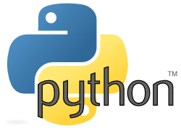
CHAPTER 1 GETTING STARTED WITH PYTHON

Slide 4
INTRODUCTION
Python is a high-level, interpreted and general-purpose dynamic programming language that focuses on code readability. The syntax in Python helps the programmers to do coding in fewer steps as compared to Java or C++.
The language founded in the year 1991 by the developer Guido Van Rossum has the programming easy and fun to do.

Slide 5
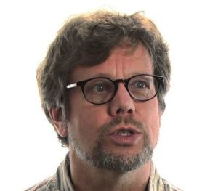
GUIDO VAN ROSSUM

Slide 6
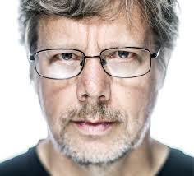
GUIDO VAN ROSSUM

Slide 7
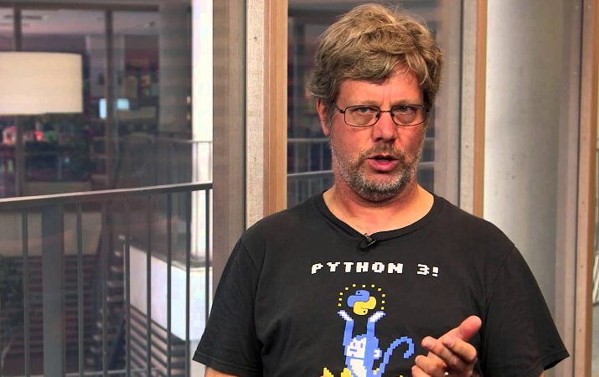
GUIDO VAN ROSSUM

Slide 8
GUIDO VAN ROSSUM
Guido van Rossum is a Dutch programmer best known as the author of the Python programming language, for which he was the "Benevolent Dictator For Life" until he stepped down from the position in July 2018.

Slide 9
GUIDO VAN ROSSUM
Born | 31 January 1956 (age 62) Haarlem, Netherlands
Residence | Belmont, California, U.S.
Nationality | Dutch
Alma mater | University of Amsterdam
Occupation | Computer programmer, author
Employer | Dropbox
Known for | Creating the Python programming language
Spouse(s) | Kim Knapp (m. 2000)
Children | Orlijn Michiel Knapp-van Rossum
Website | www.python.org/~guido/

Slide 10
INTRODUCTION
The Python is widely used in bigger organizations because of its multiple programming paradigms. They usually involve imperative and object-oriented functional programming. It has a comprehensive and large standard library that has automatic memory management and dynamic features.

Slide 11
INTRODUCTION
Python is a general-purpose language, which means it can be used to build just about anything, which will be made easy with the right tools/libraries.
Professionally, Python is great for backend web development, data analysis, artificial intelligence, and scientific computing. Many developers have also used Python to build productivity tools, games, and desktop apps, so there are plenty of resources to help you learn how to do those as well.

Slide 12
HISTORY OF PYTHON
Work on Python began in late 1989 by Guido van Rossum, then at Centrum Wiskunde (Pronounce as viskulu meaning mathematics) & Informatica CWI in the Netherlands, and eventually released for public distribution in early 1991.

Slide 13
HISTORY OF PYTHON
Where was Python created?
Python was conceived in the late 1980s, and its implementation began in December 1989 by Guido van Rossum at Centrum Wiskunde (Pronounce as viskulu meaning mathematics) & Informatica (CWI) in the Netherlands as a successor to the ABC language (itself inspired by SETL) capable of exception handling and interfacing with the Amoeba operating system.

Slide 14
HISTORY OF PYTHON
What language is Python written in?
Since most modern OS are written in C, compilers/interpreters for modern high-level languages are also written in C. Python is not an exception - its most popular/"traditional" implementation is called CPython and is written in C. There are other implementations: IronPython (Python running on .NET).

Slide 15
HISTORY OF PYTHON
How did it all begin? Innovative
Languages are usually born from one of two motivations:
(1) A large well-funded research project
or
(2) General frustration due to the lack of tools that were needed at the time to accomplish mundane and/or time-consuming tasks, many of which could be automated.

Slide 16
HISTORY OF PYTHON
How did it all begin? Innovative
At the time, van Rossum was a researcher with considerable language design experience with the interpreted language ABC, also developed at CWI (Centrum Wiskunde (Pronounce as viskulu meaning mathematics) & Informatica.P.O.Box 940791090 GB Amsterdam NETHERLANDS), but he was unsatisfied with its ability to be developed into something more.

Slide 17
HISTORY OF PYTHON
How did it all begin? Innovative
Some of the tools he envisioned were for performing general system administration tasks, so he also wanted access to the power of system calls that were available through the Amoeba distributed operating system. Although an Amoeba-specific language was given some thought, a generalized language made more sense, and late in 1989, the seeds of Python were sown.

Slide 18
HISTORY OF PYTHON
What is CWI? Where it is located?
Centrum Wiskunde (Pronounce as viskulu meaning mathematics) & Informatica (CWI) is the national research institute for mathematics and computer science in the Netherlands. Founded in 1946, CWI is part of the Institutes Organisation of NWO, NWO-I. While located at Amsterdam Science Park, this institute has strong international links, and enjoy a global reputation for innovative research.

Slide 19
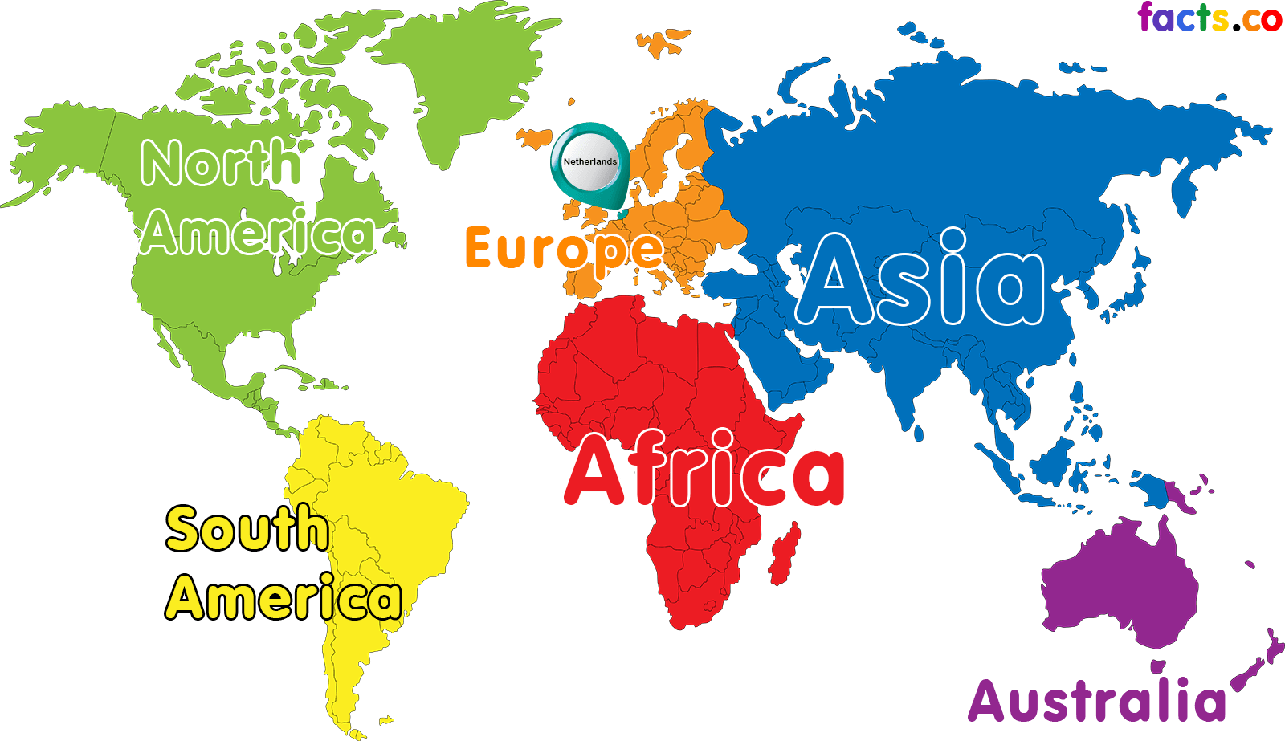
HISTORY OF PYTHON - NETHERLANDS

Slide 20
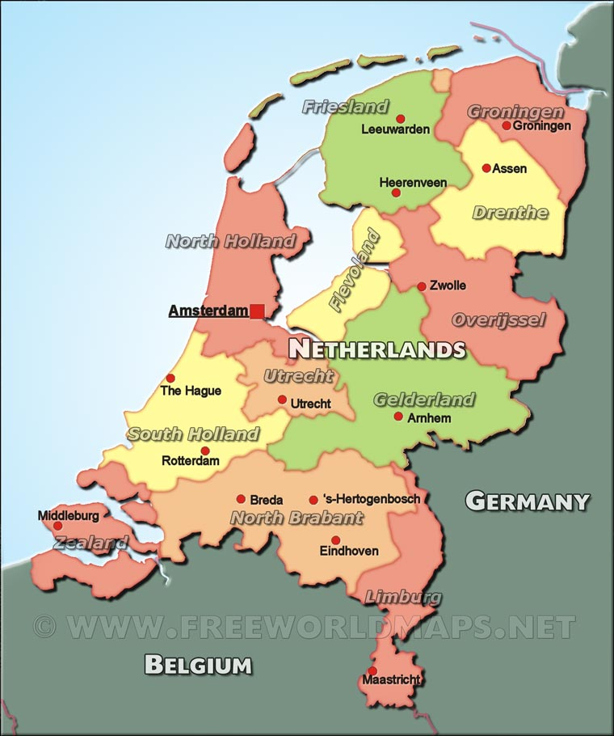
HISTORY OF PYTHON - NETHERLANDS

Slide 21
HISTORY OF PYTHON – CWI GOOGLE MAP

Slide 22
Where does the Python
name come from?

Slide 23
Where does the Python name come from?
When he began implementing Python, Guido van Rossum was also reading the published scripts from “Monty Python's Flying Circus”, a BBC comedy series from the 1970s. Van Rossum thought he needed a name that was short, unique, and slightly mysterious, so he decided to call the language Python.

Slide 24
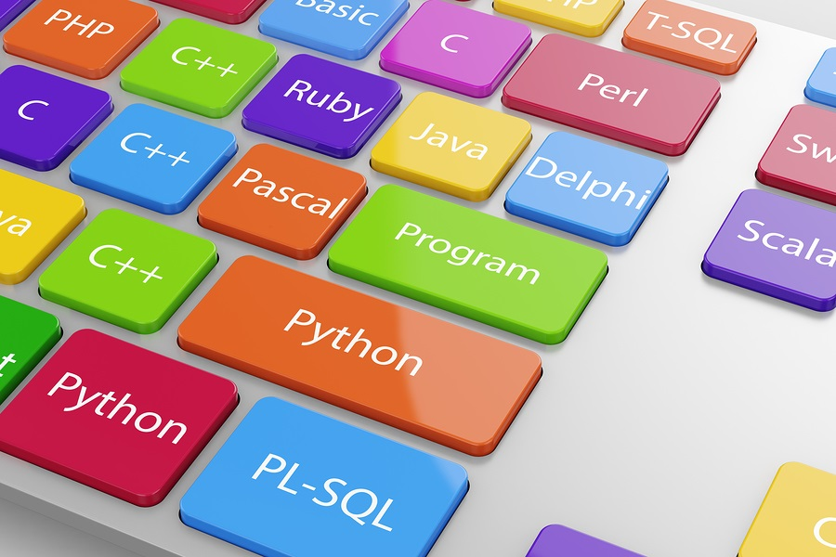
WHY COMPANIES PREFER PYTHON?

Slide 25
WHY COMPANIES PREFER PYTHON?
Python has top the charts in the recent years over other programming languages like C, C++ and Java and is widely used by the programmers. The language has undergone a drastic change since its release 25 years ago as many add-on features are introduced. The Python 1.0 had the module system of Modula-3 and interacted with Amoeba Operating System with varied functioning tools. Python 2.0 introduced in the year 2000 had features of garbage collector and Unicode Support.

Slide 26
WHY COMPANIES PREFER PYTHON?
Python 3.0 introduced in the year 2008 had a constructive design that avoids duplicate modules and constructs. With the added features, now the companies are using Python 3.5.
The software development companies prefer Python language because of its versatile features and fewer programming codes. Nearly 14% of the programmers use it on the operating systems like UNIX, Linux, Windows and Mac OS.

Slide 27
WHY COMPANIES PREFER PYTHON?
The programmers of big companies use Python as it has created a mark for itself in the software development with characteristic features like:
Interactive
Interpreted
Modular
Dynamic
Object-oriented
Portable
High level
Extensible in C++ & C

Slide 28
WHY COMPANIES PREFER PYTHON?
The programmers of big companies use Python as it has created a mark for itself in the software development with characteristic features like:
Easy-to-learn
Easy-to-read
Easy-to-maintain
Robust
Effective as a Rapid Prototyping Tool
A Memory Manager
Interpreted and (Byte-) Compiled

Slide 29
COMPANIES USING PYTHON

Slide 30
COMPANIES USING PYTHON

Slide 31
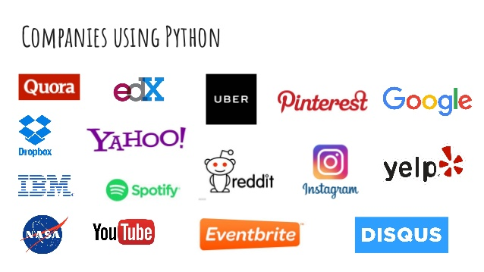
COMPANIES USING PYTHON

Slide 32
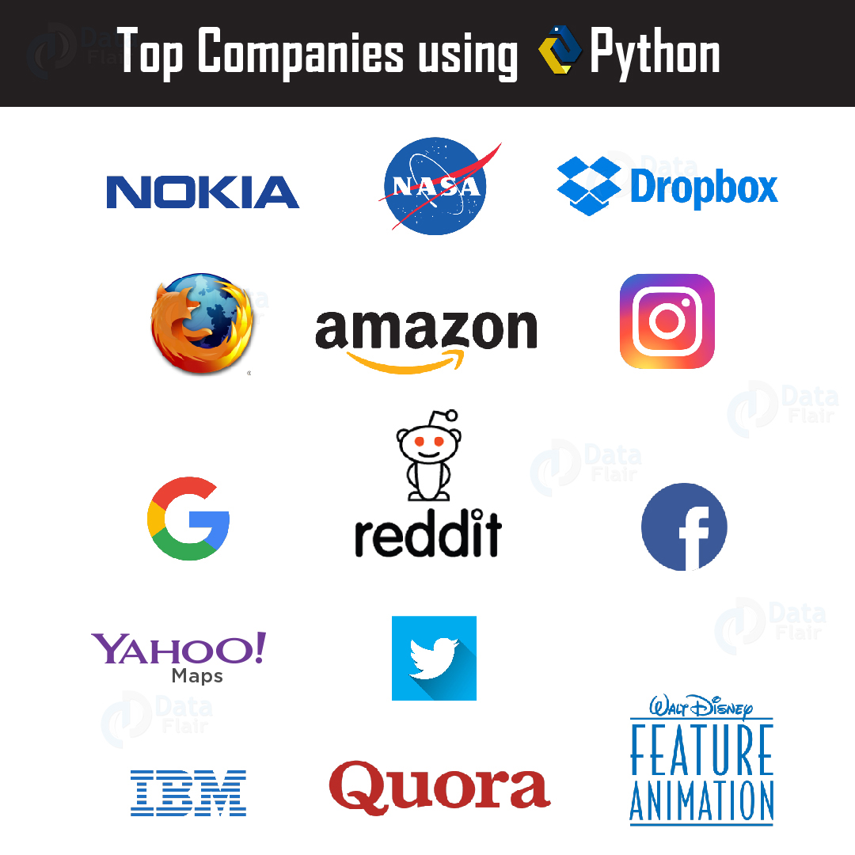
COMPANIES USING PYTHON

Slide 33
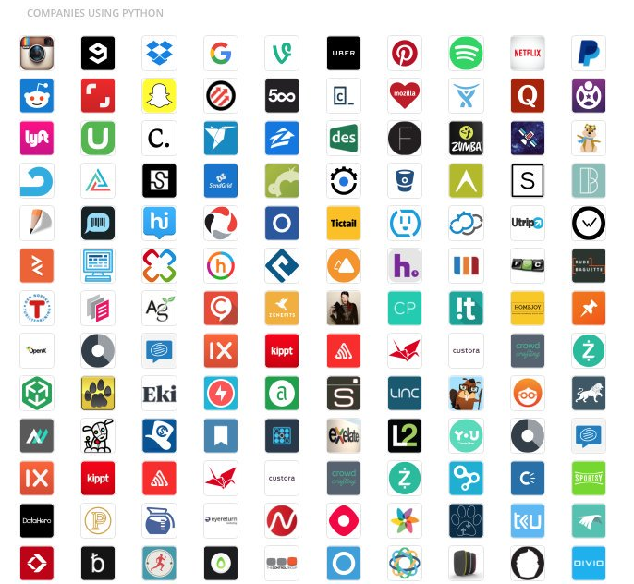
COMPANIES USING PYTHON

Slide 34
PYTHON ADVANTAGES - PLUS POINTS

Slide 35
PYTHON ADVANTAGES - PLUS POINTS
01. Easy to Use.
02. Expressive Language.
03. Interpreted Language.
04. Its Completeness.
05. Cross Plat Form Language.
06. Free and Open Source.
07. Variety of Usage/Applications.

Slide 36
PYTHON ADVANTAGES - PLUS POINTS
08. Interactive.
09. Modular.
10. Dynamic.
11. Object-oriented.
12. Portable.
13. High level.
14. Extensible in C++ & C.

Slide 37
PYTHON ADVANTAGES - PLUS POINTS
15. Easy-to-learn .
16. Easy-to-read.
17. Easy-to-maintain.
18. Robust.
19. Effective as a Rapid Prototyping Tool
20. A Memory Manager.
21. Interpreted and (Byte-) Compiled.
22. Multi paradigm language.

Slide 38
PYTHON ADVANTAGES - PLUS POINTS
23. Acts as foundation to learn other languages.
24. Perfect to build prototypes.
25. Flexible.
26. Case Sensitive Language.
27. Structured programming language.
30. Scientific Language.
31. General purpose language.

Slide 39
PYTHON DISADVANTAGES

Slide 40
PYTHON DISADVANTAGES - MINUS POINTS
01. Speed.
02. Mobile Development.
03. Easy-to-maintain.
04. Memory Consumption.
05. Database Access.
06. Runtime Errors.
07. Not Strong on Type-Binding or Dynamic Typing.

Slide 41
PYTHON DISADVANTAGES - MINUS POINTS
08. Python is evolving continuously.
09. Not a great choice for a high-graphic 3d game.
10. Designs issues.
11. Memory Consumption.
12. Simple rules.

Slide 42
COMPILERS AND INTERPRETERS

Slide 43
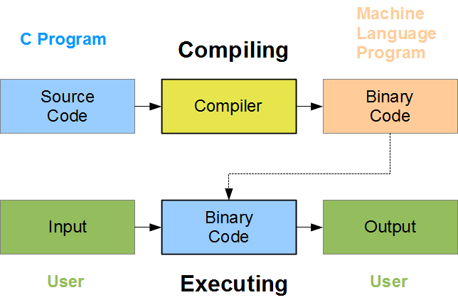
COMPILER
Its a translator used to convert HLL to MLL and vice versa.

Slide 44
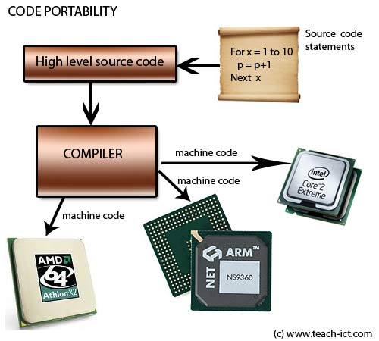
COMPILER
Its a translator used to convert HLL to MLL and vice versa.

Slide 45
INTERPRETER
Its a translator used to convert HLL to MLL and vice versa.

Slide 46
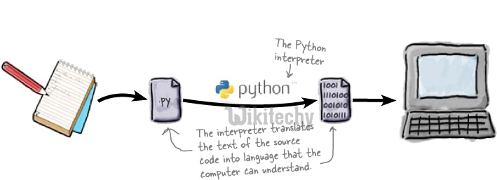
INTERPRETER
Its a translator used to convert HLL to MLL and vice versa.

Slide 47
WORKING IN PYTHON

Slide 48
WORKING IN PYTHON
Python is free, open-source software that works on Linux, Mac, Windows, and various other platforms (21 in total).
It comes preinstalled on Mac and most distributions of Linux.
There are multiple python distributions available.

Slide 49
PYTHON DISTRIBUTION

Slide 50
PYTHON DISTRIBUTION
What is Python distribution?
A Python distribution is a software bundle, which contains a Python interpreter and the Python standard library. Installer programs for common operating systems.

Slide 51
PYTHON DISTRIBUTION
Aside from the official CPython distribution available from python.org, other distributions based on CPython include the followings:

Slide 52
SOME OF PYTHON DISTRIBUTION

Slide 53
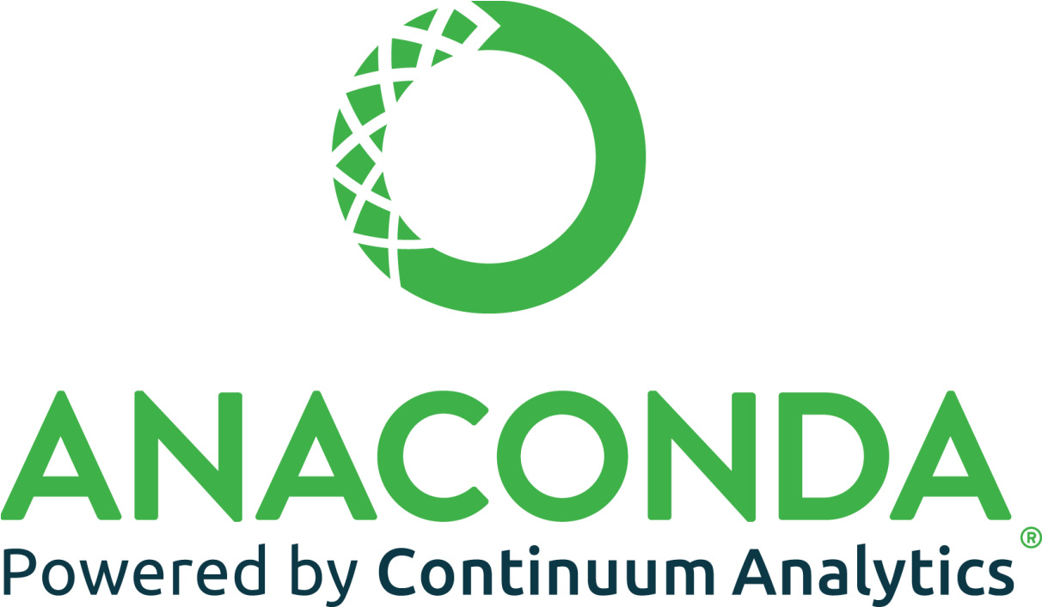
SOME OF PYTHON DISTRIBUTION

Slide 54
SOME OF PYTHON DISTRIBUTION
ENTHOUGHT'S CANOPY

Slide 55
SOME OF PYTHON DISTRIBUTION
WINPYTHON

Slide 56
SOME PYTHON DISTRIBUTION
CHINESEPYTHON PROJECT: Translation of Python's keywords, internal types and classes into Chinese. Eventually allows a programmer to write Python programs in Chinese.

Slide 57
Integrated
Development
Environment
(IDE)

Slide 58
What is an IDE?
An integrated development environment (IDE) is a software application that provides comprehensive facilities to computer programmers for software development.
An IDE normally consists of a source code editor, build automation tools, and a debugger. Most modern IDEs have intelligent code completion.

Slide 59
PYTHON IDE / IDLE

Slide 60
PYTHON IDE / IDLE
What is Python IDE or IDLE?
IDLE (short for integrated development environment or integrated development and learning environment) is an integrated development environment for Python, which has been bundled with the default implementation of the language since 1.5.2b1. ... Pythonshell with syntax highlighting.

Slide 61
POPULAR PYTHON IDEs

Slide 62
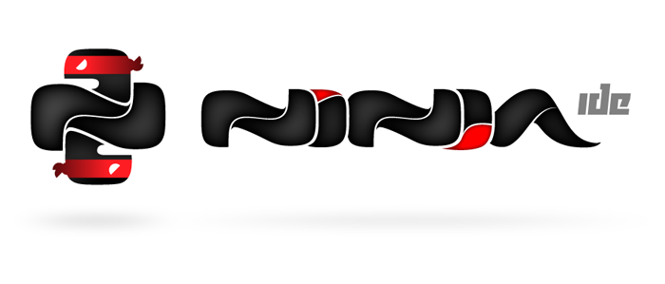
POPULAR PYTHON IDEs
GitHub : NINJA IDE

Slide 63
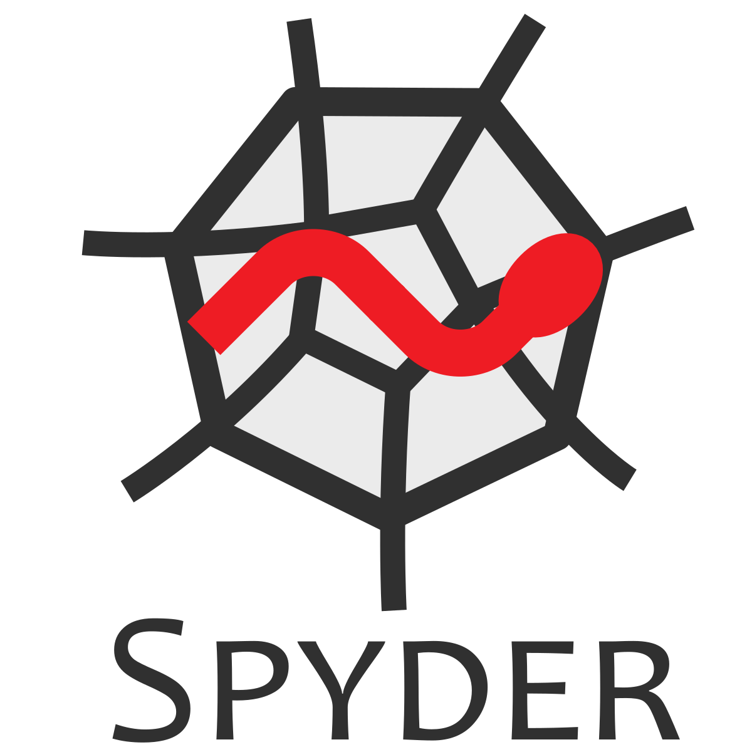
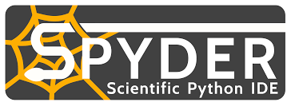
POPULAR PYTHON IDEs
SPYDER

Slide 64
POPULAR PYTHON IDEs
ECLIPSE

Slide 65
POPULAR PYTHON IDEs
DJANGO

Slide 66
POPULAR PYTHON IDEs
PYSCRIPTER

Slide 67
POPULAR PYTHON IDEs
BeeWare

Slide 68
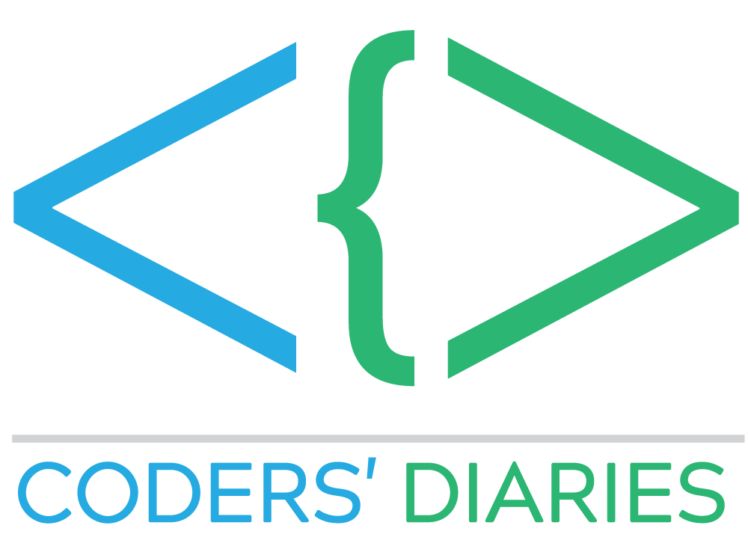
POPULAR PYTHON IDEs
CODERS’ DIARIES

Slide 69
POPULAR PYTHON IDEs
ERIC

Slide 70
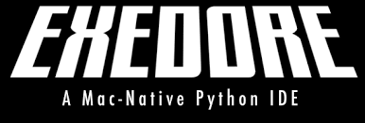
POPULAR PYTHON IDEs
EXEDORE

Slide 71
POPULAR PYTHON IDEs
WING

Slide 72
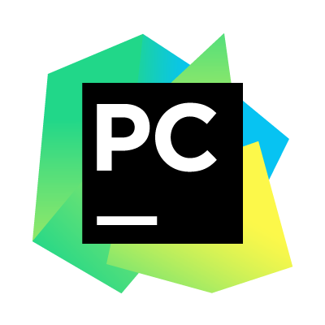
POPULAR PYTHON IDEs
PYCHARM

Slide 73
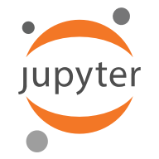
POPULAR PYTHON IDEs
JUPYTER

Slide 74
PYTHON EDITORS
KOMODO

Slide 75
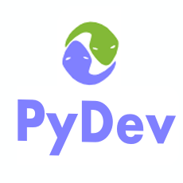
POPULAR PYTHON IDEs
PYDEV

Slide 76
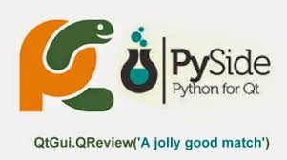
POPULAR PYTHON IDEs
PYSIDE

Slide 77
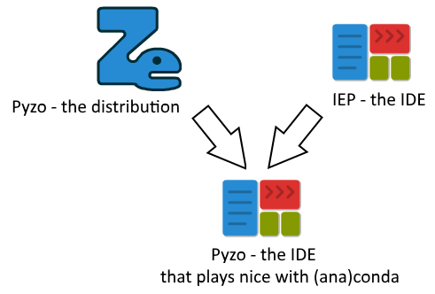
POPULAR PYTHON IDEs
PYZO

Slide 78
POPULAR PYTHON IDEs
RUBYMINE

Slide 79
POPULAR PYTHON IDEs
RODEO

Slide 80
PYTHON EDITORS

Slide 81
PYTHON EDITORS
KOMODO

Slide 82
PYTHON EDITORS
EMACS

Slide 83
PYTHON EDITORS
GEDIT

Slide 84
PYTHON EDITORS
ATOM

Slide 85
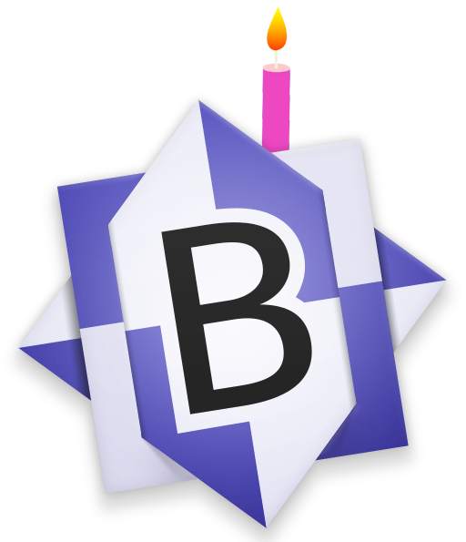
PYTHON EDITORS
BBEDIT

Slide 86
PYTHON EDITORS
BLUE FISH

Slide 87
PYTHON EDITORS
EDITRA

Slide 88
PYTHON EDITORS
LIO

Slide 89
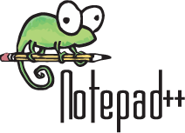
PYTHON EDITORS
NOTEPAD++

Slide 90
PYTHON EDITORS
SUBLIME

Slide 91
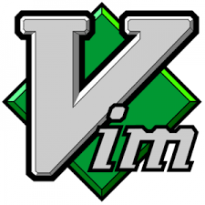
PYTHON EDITORS
VIM

Slide 92
PYTHON EDITORS
TEXTMATE

Slide 93
PYTHON EDITORS
TEXTWRANGLER

Slide 94
WORKING WITH DEFAULT CPYTHON DISTRIBUTION

Slide 95
PYTHON INTRACTIVE MODE PYTHON IDLE

Slide 96
PYTHON SHELL
What is Shell?
A shell is usually an "interactive shell", usually termed a REPL which stands for "Read - Execute - Print - Loop" Most interpreted languages offer a REPL interface - whether its LISP, python, BASIC or Javascript or even DOS batch language or Unix Shells. The interpreter is what actually executes the lines of code.

Slide 97
PYTHON SHELL
What is Python Shell or Python Interactive Shell?
The Python interpreter can be used from an interactive shell. The interactive shell is also interactive in the way that it stands between the commands or actions and their execution. ... Python offers a comfortable command line interface with the Python shell, which is also known as the "Python interactive shell".

Slide 98
PYTHON SHELL IDLE

Slide 99
PYTHON BASIC MODES
What are the basic modes of python?
Python has two basic modes:
Script and
2) Interactive.

Slide 100
PYTHON BASIC MODES
1) Script Mode:
The normal mode is the mode where the scripted and finished .py files are run in the Python interpreter.

Slide 101
PYTHON BASIC MODES
2) Interactive Mode:
Interactive mode is a command line shell which gives immediate feedback for each statement, while running previously fed statements in active memory.

Slide 102
SCRIPT
What is Script?
Scripts are reusable. Basically, a script is a text file containing the statements that comprise a Python program. Once you have created the script, you can execute it over and over without having to retype it each time. Scripts are editable.

Slide 103
INVOKING SCRIPT MODE

Slide 104
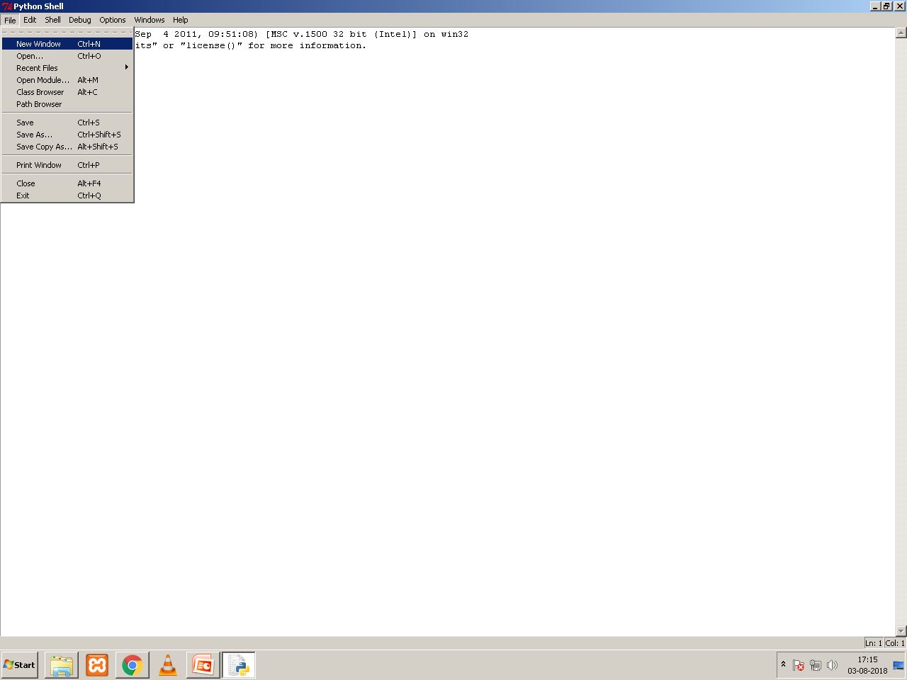
INVOKING SCRIPT MODE

Slide 105
INVOKING SCRIPT MODE

Slide 106
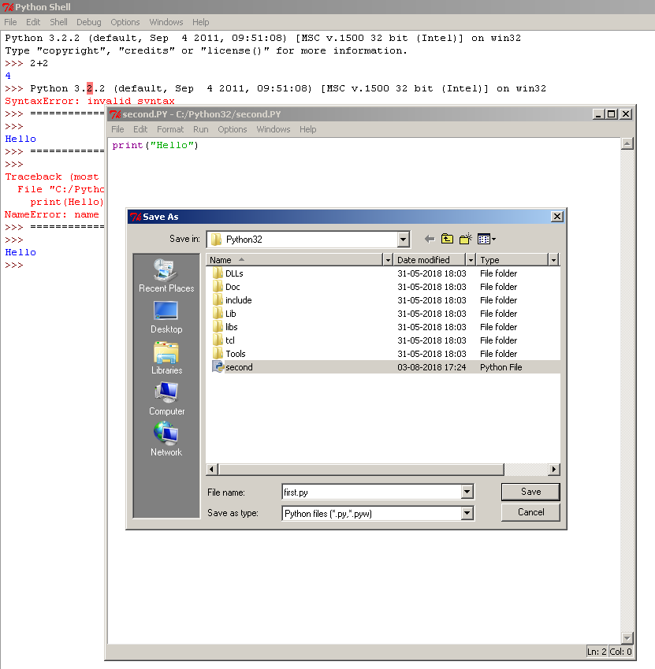
Saving Script / Program File
Click On File
Select Save
Give filename with py extension
For Example:
first.py
Or
first.PY

Slide 107
Running or Executing Program / Script
Click On Run
Select
Run Module
Or
F5

Slide 108
WORKING IN ANACONDA

Slide 109
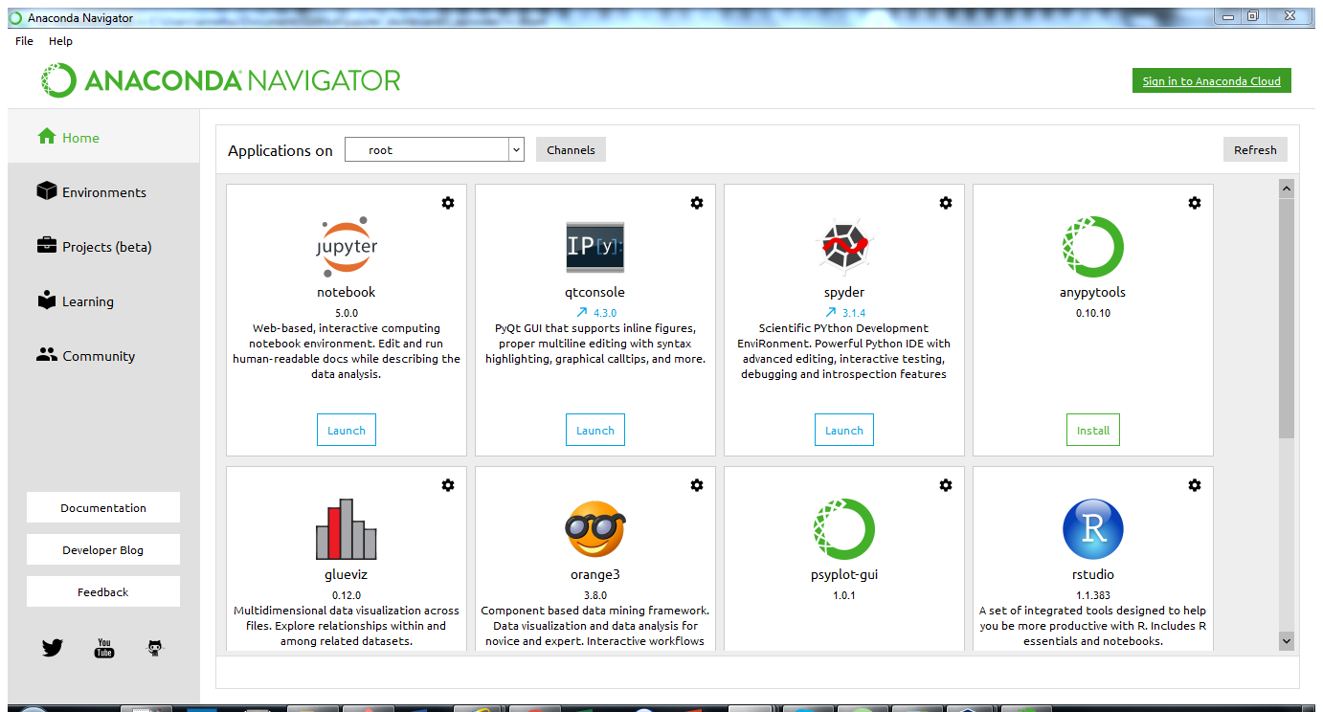
ANACONDA NAVIGATOR

Slide 110
JUPYTER NOTEBOOK IDE
What is Jupyter Notebook?
The Jupyter Notebook is an ANACONDA TOOL and is an open-source web application that allows you to create and share documents that contain live code, equations, visualizations and narrative text.
Note: Jupyter Notebook runs on your browser.

Slide 111
JUPYTER NOTEBOOK IDE

Slide 112
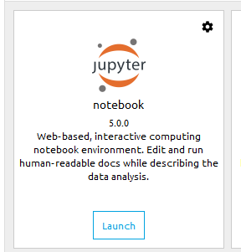
JUPYTER NOTEBOOK IDE

Slide 113
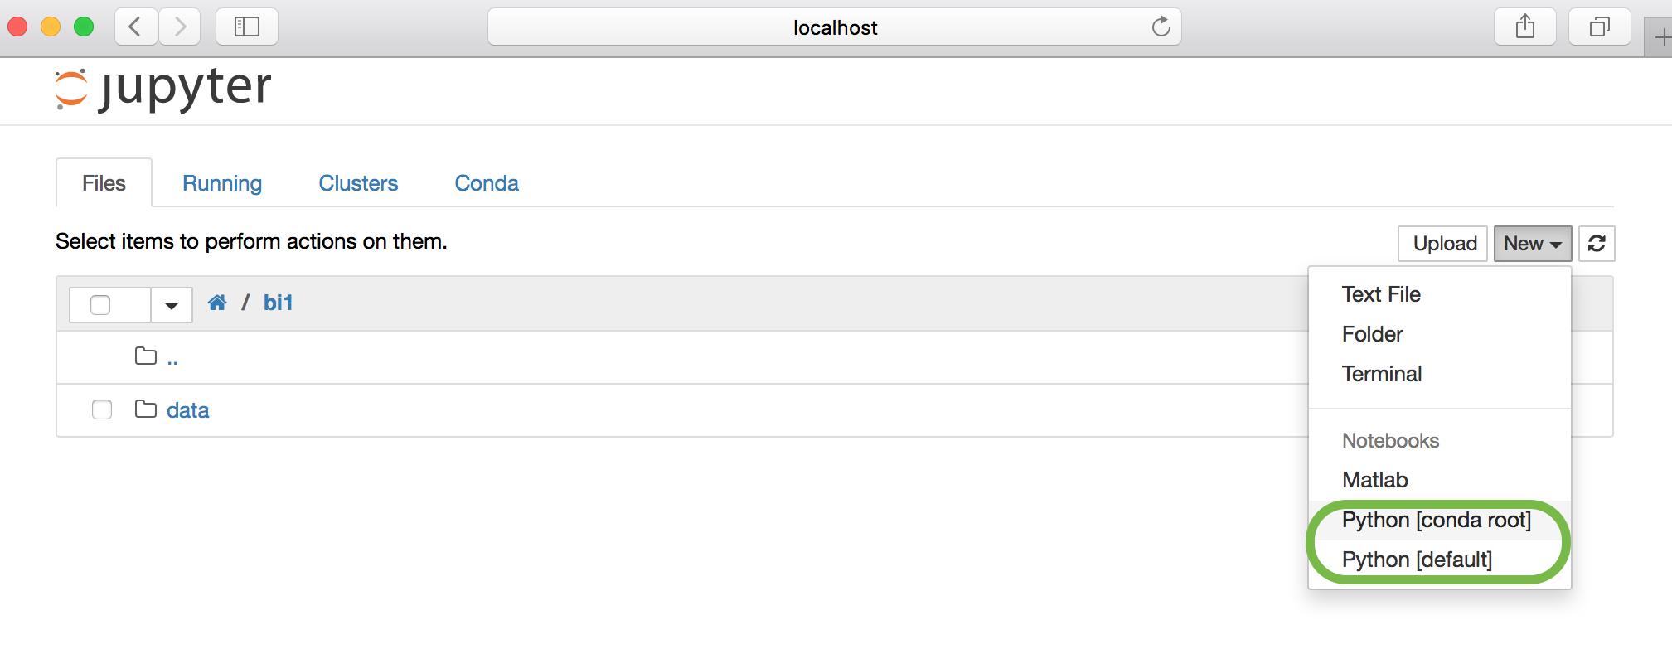
JUPYTER DASHBOARD

Slide 114
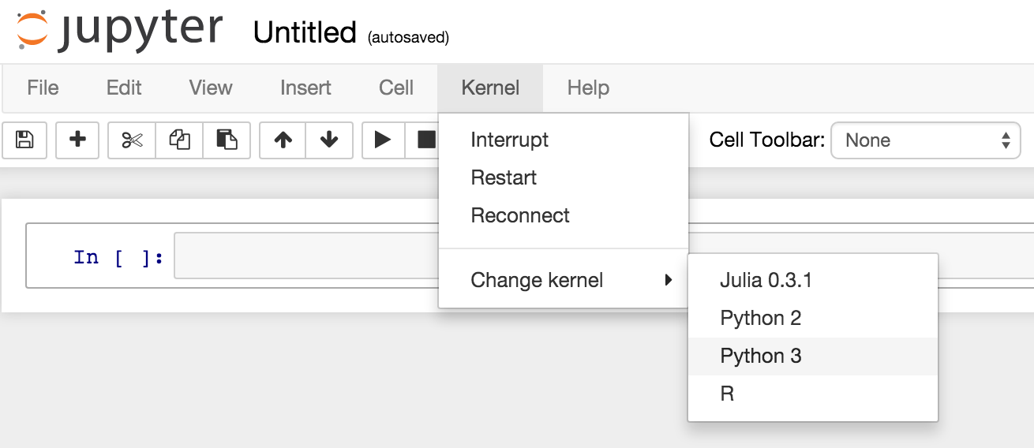
JUPYTER INTERACTIVE MODE

Slide 115
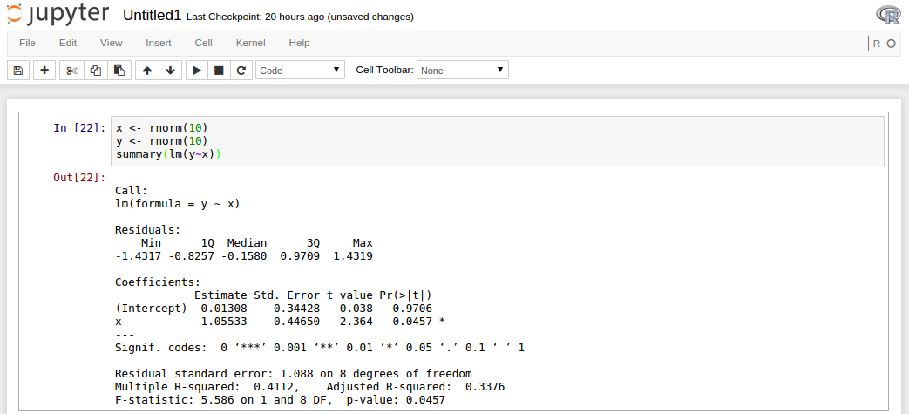
JUPYTER SCRIPT MODE

Slide 116
SPYDER IDE

Slide 117
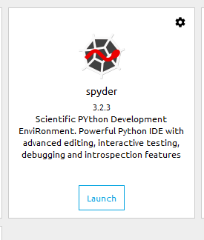
SPYDER IDE

Slide 118
SPYDER IDE
What is Spyder?
Spyder is an open source cross-platform integrated development environment (IDE) for scientific programming in the Python language

Slide 119
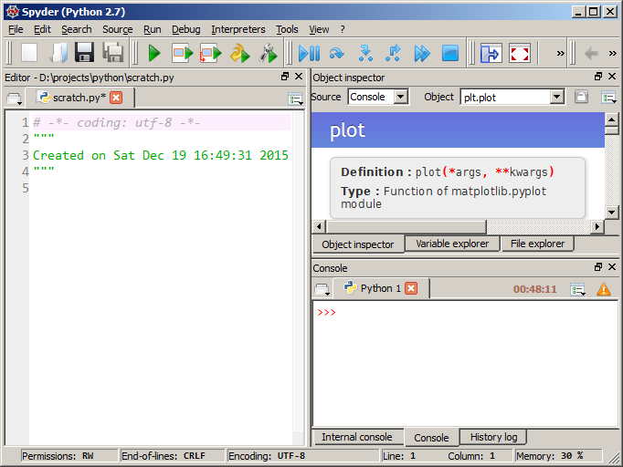
SPYDER IDE

Slide 120
PyScripter IDE

Slide 121
PyScripter IDE
What is PyScripter?
PyScripter is a free and open-source Python Integrated Development Environment (IDE) created with the ambition to become competitive in functionality with commercial Windows-based IDEs available for other languages

Slide 122
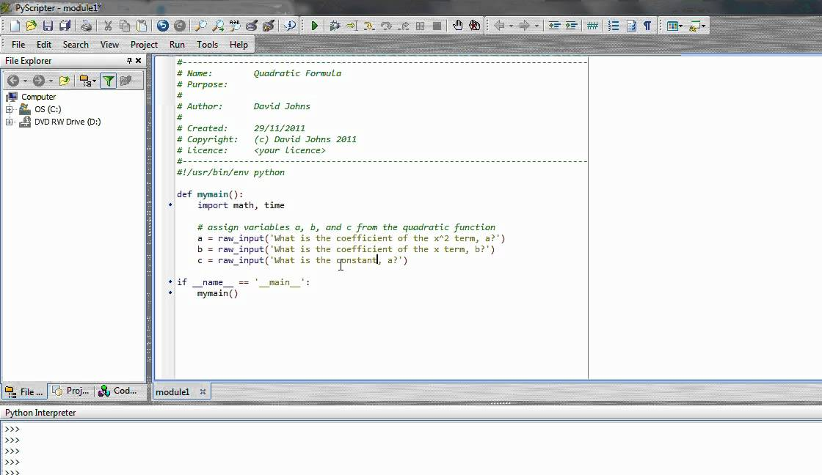
PyScripter IDE

Slide 123
Any Questions Please

Slide 124
Class Test

Slide 125
Class Test
Two Marks each. ( 10 x 2 =20 )
What is python?
Who Developed python?
In which year the python came in to existence?
How did it all begin? Innovative python
Where does the Python name come from?
How python acts as a foundation to learn
other languages?

Slide 126
Class Test
7. What is Python Shell or Python Interactive Shell?
8. What is Script mode?
9. What is Jupyter Notebook?
10. What is Spyder?

Slide 127
QUESTION BANK

Slide 128
QUESTION BANK
One Mark Questions
What is python?
Who Developed python?
In which year the python came in to existence?
How did it all begin? Innovative python
Where does the Python name come from?
How python acts as a foundation to learn other languages?
What is translator?
What is compiler?

Slide 129
QUESTION BANK
One Mark Questions
09. What is interpreter?
10. What is an IDE?
11. What is Python IDE or IDLE?
12. What is an editor?
13. How editor is different from IDE?
14. List any four editors
15. What is shell?
16. What is Python Shell or Python Interactive Shell?
17. What is Script mode?

Slide 130
QUESTION BANK
One Mark Questions
18. What is interactive mode?
19. What is the extension of python program/script?
20. What is the shortcut key to execute or run the script?
21. What is anaconda navigator?
22. What is Jupyter Notebook?
23. What is Spyder?
24. What is PyScripter?
25. Is python supports object oriented programming?

Slide 131
QUESTION BANK
One Mark Questions
26. What is the shortcut key to exit from python shell?
27. Which function is used to quit python shell?
28. What is quit() function?
29. What is exit() function?
30. What is Debug?
31. What is the function key to run/execute a python program?
Two Marks Questions
01. Differentiate between compiler and interpreter

Slide 132
QUESTION BANK
Two Mark Questions
02. Why companies prefer python?
03. List any 5 companies using python
04. What are the advantages of python
05. What are the disadvantages of python
06. What is Cross plat form language?
07. What is Python distribution?
08. List any four Python IDEs
09. Differentiate between Script mode and interactive mode
10. Write down the steps to invoke python software

Slide 133
QUESTION BANK
Two Mark Questions
11. What are the basic modes of python?
12. Write down the steps to invoke python script mode
13. Write down the steps to run/execute a program or script
3 Marks Questions:
1. Write a note on history of Python
2. Draw and explain the screen elements of Python

Slide 134
QUESTION BANK
Three Mark Questions
3. What is multi paradigm programming language? is Python multi paradigm programming language justify your answer
4. What are the benefits of IDEs?
5. Explain any two popular Python IDEs
***

Slide 135
Thank You

